Slide 1
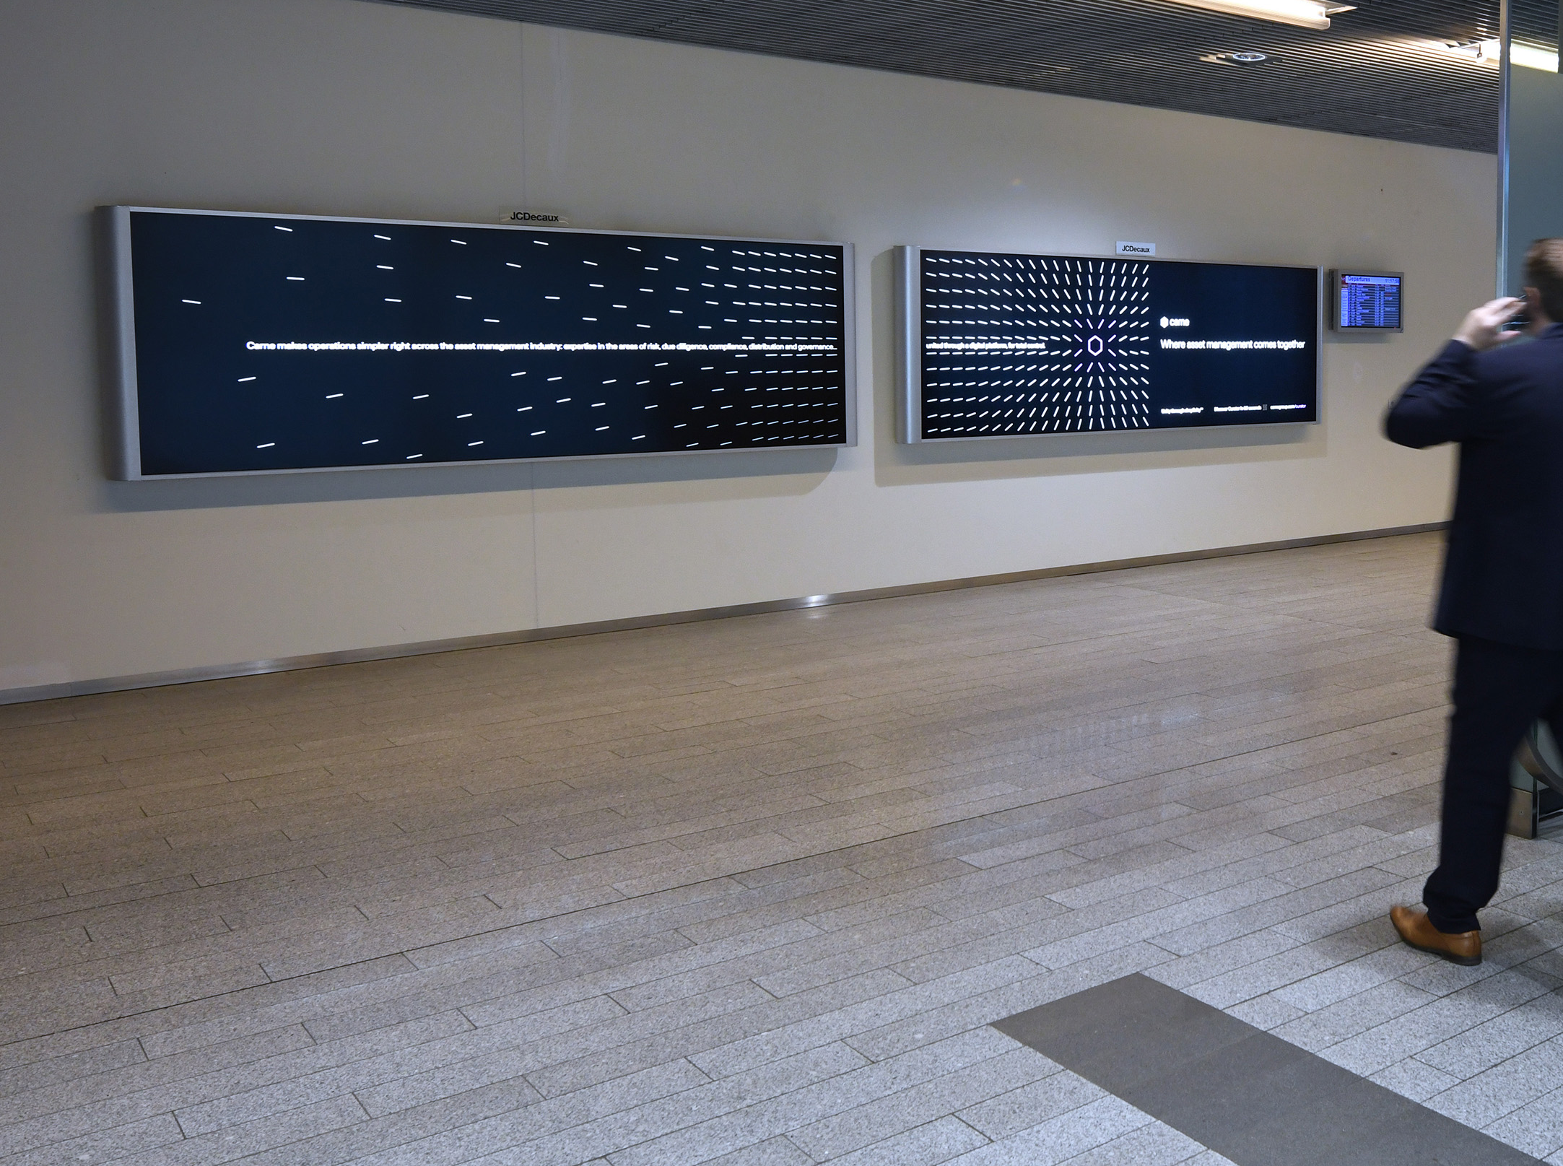
DUO OPTIMAL NON SCHENGEN
Target 100% of the passengers from London City
Head-on visibility to impact the target and backlit visibility

Slide 2
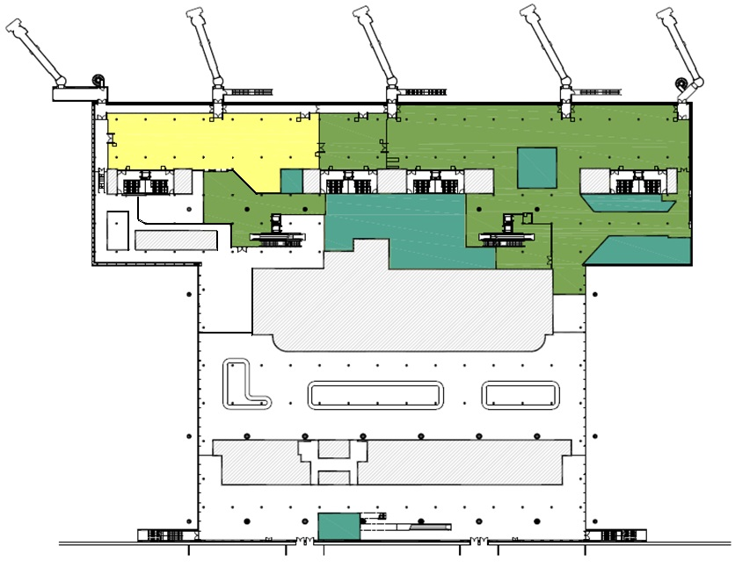
DUO OPTIMAL NON SCHENGEN
Location
Area : Non Schengen arrivals
Audience : All Non Schengen tarmac arriving passengers
Nb of unit : 2
Boarding
Non-Schengen
Boarding
Schengen
Shop
Duty Free
Shop
Restaurant
Luggage Hall
Arrival Public Hall
Specification
Format : 2x Lightbox 360 x 120 cm

