Slide 1
BRUSSELS AIRPORT | MEDIA PRODUCTS
ARRIVAL TRAVELLING TUNNEL #2
AIRSIDE
ARRIVALS
SCHENGEN

Slide 2
BRUSSELS AIRPORT | MEDIA PRODUCTS
ARRIVAL TRAVELLING TUNNEL #2
AIRSIDE
ARRIVALS
SCHENGEN
MEDIA BENEFITS:​
Prime visibility on the way towards the baggage reclaim.
Highly powerful reaching 100% of the Schengen arrivals.​
Format | Large Format Lightbox back illuminated
Dimensions | 18 sqm (m²)
Location | Connector Arrival – Pier A
Audience | Schengen arrivals
Minimum booking | 28 days (4 weeks)
Share of time | 100% Exclusive
Language | English Mandatory

Slide 3
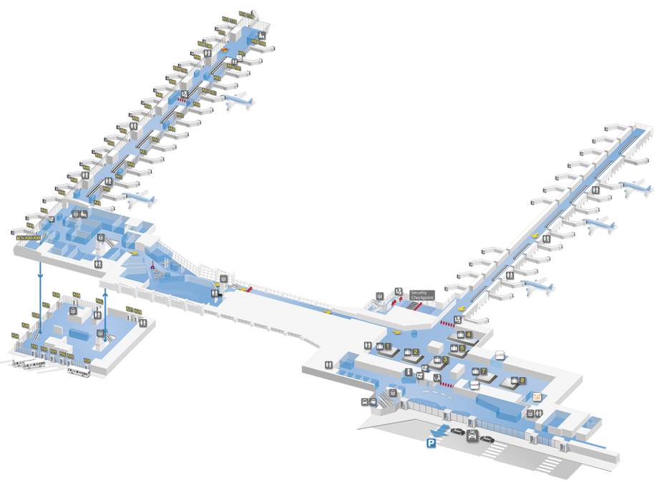
BRUSSELS AIRPORT | MEDIA PRODUCTS
ARRIVAL TRAVELLING TUNNEL #2
AIRSIDE
ARRIVALS
SCHENGEN

Slide 4
BRUSSELS AIRPORT | MEDIA PRODUCTS
ARRIVAL TRAVELLING TUNNEL #2
AIRSIDE
ARRIVALS
SCHENGEN
File characteristics
File characteristics
Visual dimensions
Others
Visual dimensions
Adobe PDF is the standard for the exchange of composite digital files.
The creation of Adobe PDF files can easily be done from Adobe Indesign.
• We only accept Adobe PDF (1.4 to 1.7) files. (1 visual = 1 PDF)
• The size of the pdf file must be 1/10 of the real format + 10 mm bleed
• The image resolution should be 450 dpi (on 1/10 file size)
• All elements (images and vector) used in the document must be in CMYK (No RGB or spot color)
For more information on how to create a valid Adobe PDF file look to the userguide page “HOW MAKE A GOOD PDF”.
Visible Area: 1132 cm x 162 cm Area corresponding to the visible part of the layout once installed. All elements out of this area / format are in the bleed part and will not be visible.
Overall Format: 1152 cm x 182 cm Final format of the file to be supplied. Format corresponding to the visible format + bleed. Do not include any text, logo or pictures you want to have visible in the bleed part. Bleed is technically needed and will not be visible on the final installed layout.
Control
Control of the file by our supplier. Corrections if needed with a 2 working days delay
Production lead-time
10 working days from receipt of files
Delivery
Deliver file with WeTransfer or similar to: prodairport@jcdecaux.com
1152
162
182
1132

